Slide 1
Preparing...

Slide 2


The Second Class - Basic Numpy

Slide 3
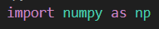
import Numpy
In your python file import like this
(In convention, we import numpy as np)

Slide 4
Numpy Intro
Let s start our numpy journey
’

Slide 5
Numpy Intro - What is numpy?
Numpy is a important and fundamental package in python.
Supporting lots of math function for multi-dimensional array and matrix operations.

Slide 6
Numpy Intro - Why we use numpy?
Widely used in the fields of science and engineering.
The core of numpy is written in C/C++ , and it execute very fast
(much faster than python list)

Slide 7
Numpy Intro - Array
1D Array
1 3 4 2
In numpy, we use array instead of python list
Numpy array is similar to Python list
(ndarray)
Axis 0
2D Array
1 3 4 2
1 3 4 2
Axis 0
Axis 1

Slide 8
Create a Numpy Array
#WeCreate

Slide 9
Common ways to create array
Here we introduce some common methods.
array() , arrange() ,
empty() , ones() , zeros() , full() , identity()

Slide 10
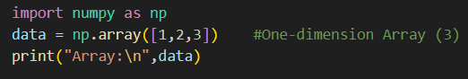
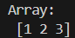
Creating Array - array()
Usage: array(object[, dtype, copy, order, subok, ...])
(For beginner, we can ignore things in square brackets now.)
object: any object exposing the array interface.
For example: python List
Create a array from existing object

Slide 11
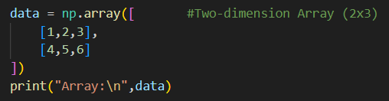
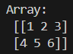
Creating Array - array()
I want to create multi-dimensional array. How to do that?
→ Let List be wrapped in List
As the following code

Slide 12
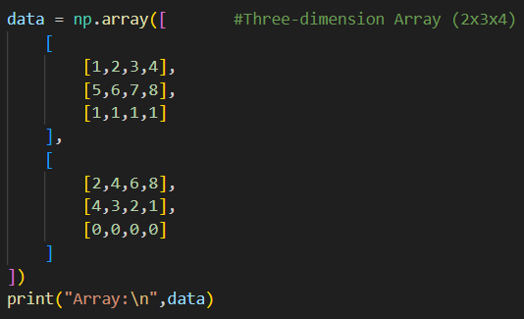
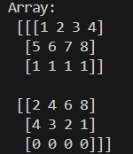
Creating Array - array()
In higher dimension, it is also similar.

Slide 13
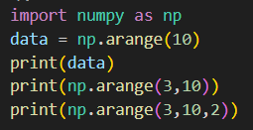
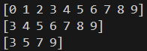
Creating Array - arange()
Usage: arange([start,] stop[, step,][, dtype, ...])
In general, it is similar to range().

Slide 14
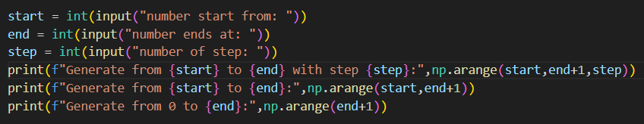
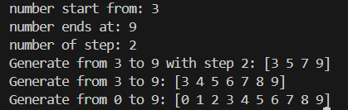
Creating Array - arange()

Slide 15
Creating Array - linspace()
Usage: linspace(start, stop[, num=50][, endpoint=True][, retstep=False][, dtype][, axis=0, ....])
Returns num evenly spaced samples, calculated over the interval [start, stop].
Just like take some points in a specific interval

Slide 16
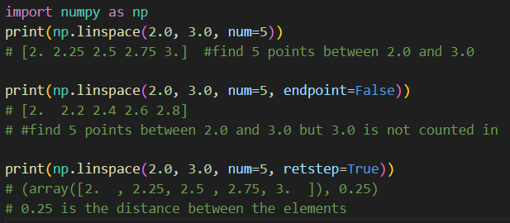
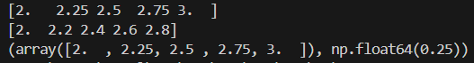
Creating Array - linspace()

Slide 17
Creating Array - empty()
Usage: empty(shape[, dtype, order, device, like])
shape: a tuple indicating the shape of array
(What does the array look like)
For example:(3,) means 1d and 3 element in axis0
(2,3) means 2d and 2 element in axis0 3 element in axis1
It will return a new array of given shape, without initializing entries.

Slide 18
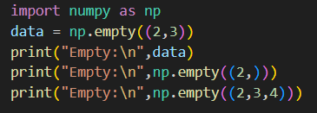
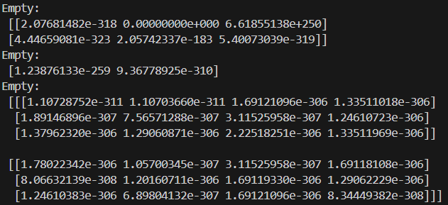
Creating Array - empty()
Usage: empty(shape[, dtype, order, device, like])
It will return a new array of given shape, without initializing entries.
It looks strange, right?

Slide 19
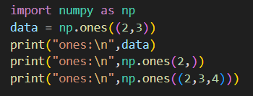
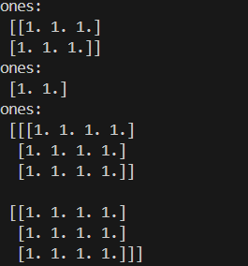

Creating Array - ones()
Usage: ones(shape[, dtype, order, device, like])
It will a new array of given shape, filled with ones.
:D

Slide 20
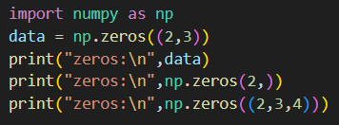
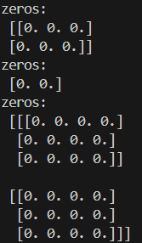
Creating Array - zeros()
Usage: zeros(shape[, dtype, order, like])
It will a new array of given shape, filled with zeros.

Slide 21
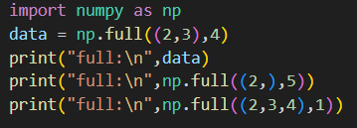
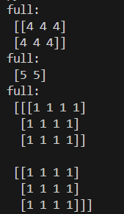
Creating Array - full()
Usage: full(shape, fill_value[, dtype, order, ...])
It will a new array of given shape, filled with fill_value.

Slide 22
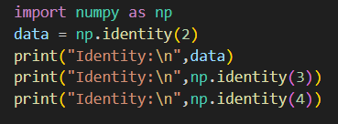
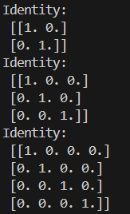
Creating Array - identity()
Usage: identity(n[, dtype, like])
n: Number of rows (and columns) in n x n output.
It will return the nxn identity array.

Slide 23
Array attributes
Have a better understanding of
dimension and shape

Slide 24
Array attributes
Here we introduce three array attributes
ndim : The number of dimensions of an array
shape : a tuple of non-negative integers that specify the number of elements along each dimension.
size : total number of elements in array

Slide 25
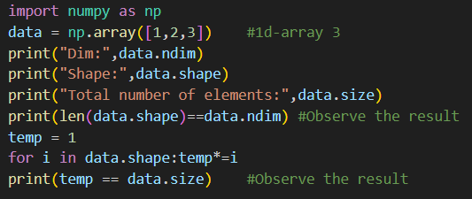
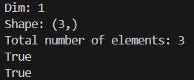
Array attributes

Slide 26
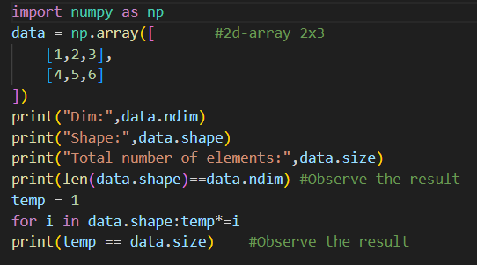
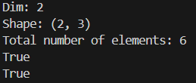
Array attributes

Slide 27
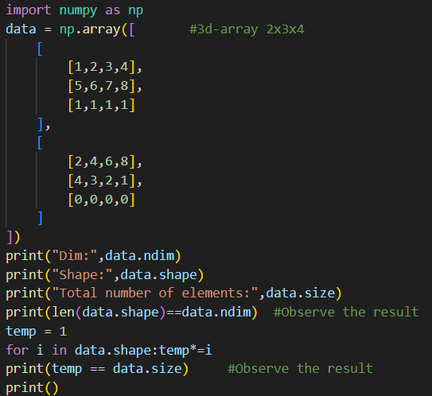
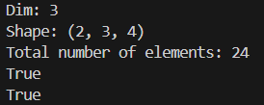
Array attributes

Slide 28
Array Operation
.

Slide 29
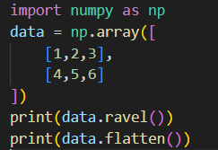
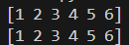
Flatten an array
Convert a multi-dimensional array into a 1-d array
There are two methods to do this. ravel() flatten()

Slide 30

Flatten an array
It seems they are same thing. There are no difference?
Convert a multi-dimensional array into a 1-d array
There are two methods to do this. ravel() flatten()

Slide 31
Flatten an array
But if that's the case, why does numpy have two functions with different names but the same function
Convert a multi-dimensional array into a 1-d array
There are two methods to do this. ravel() flatten()

Slide 32
Flatten an array
But if that's the case, why does numpy have two functions with different names but the same function
Convert a multi-dimensional array into a 1-d array
There are two methods to do this. ravel() flatten()
In fact, there are some difference between ravel() and flatten() !

Slide 33
Flatten an array
The biggest difference between ravel and flatten is :
flatten() will create a new array (modify the new array won t modify original array)
ravel() won t create a new array, but a reference instead. (modify the array ravel() return will modify the original array)
’
’

Slide 34
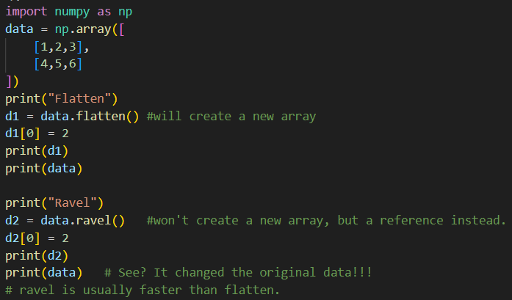
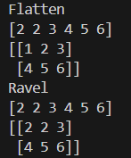
Flatten an array

Slide 35
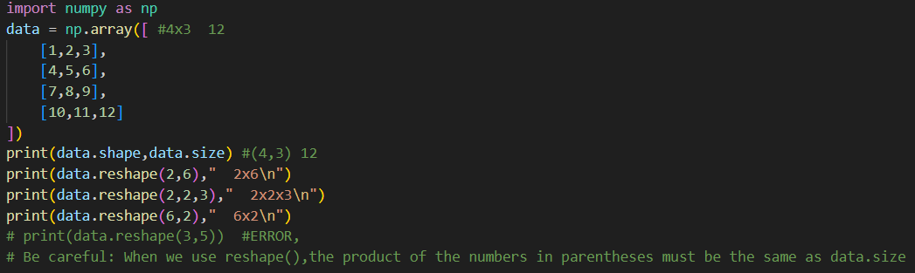
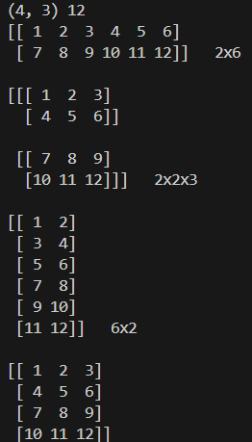
Reshape an array
usage: reshape(the shape you want convert it to)
Be careful: When we use reshape(),the product of the numbers in parentheses must be the same as data.size

Slide 36
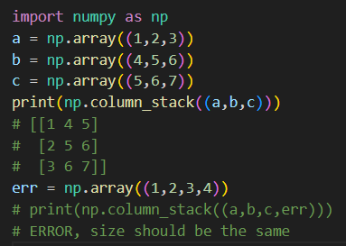
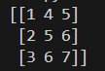
Column_stack
Take a sequence of 1-D arrays and stack them as columns to make a single 2-D array.

Slide 37
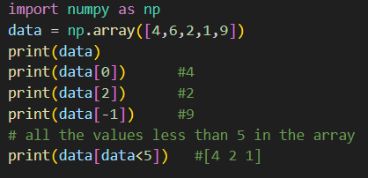
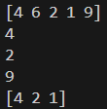
Indexing
Conceptually the same as indexing in a Python list

Slide 38
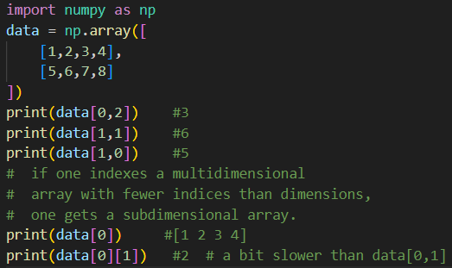
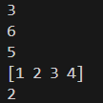
Indexing
The indexing in Higher dimension.

Slide 39
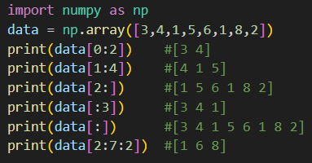
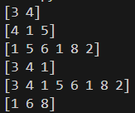
Slicing
Conceptually the same as slicing in a Python list

Slide 40
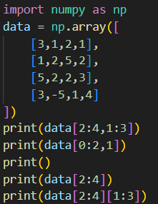
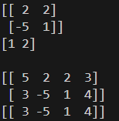
Slicing
The slicing in Higher dimension.

Slide 41
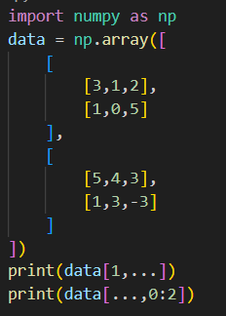
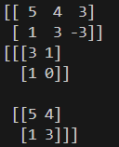

Ellipsis
selecting in full any remaining unspecified dimensions.
I want it all

Slide 42
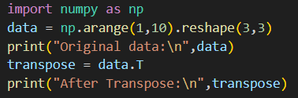
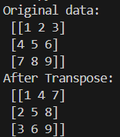
Transpose
Transpose the array

Slide 43
Array computation
.

Slide 44
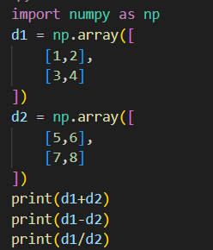
Computation between arrays
For operators + - / , the calculation concept is as follows
1
2
5
6
6
8
+
=
3
4
7
8
10
12

Slide 45

Computation between arrays
(element by element)

Slide 46


Computation between arrays
Note * operator. It is not matrix multiplication.
* is calculated similarly to the + - / operator.
(element by element)

Slide 47


Computation between arrays
matrix multiplication.

Slide 48


Computation between array and number

Slide 49


useful array operations
max() min() mean() sum() prod() std()

Slide 50


Inverse and Round

Slide 51


Inverse and Round

Slide 52
Exercises
Practice makes perfect

Slide 53


Matrix Sum
Q: Given two matrix A,B, Return the result of Matrix A + Matrix B
your goal is to write this function

Slide 54

Matrix Sum
Sample solution

Slide 55



I dont want the edge of matrix
Q: Given a matrix, return the central part of the matrix (i.e., remove the edges), and flatten the result

Slide 56

I dont want the edge of matrix
Sample solution

Slide 57


Rotation Matrix
Q: Given a point np.array([x,y]) and theta(Deg), return the result of rotating the point counterclockwise theta degrees
rad_angle = (np.pi/180) * theta_deg
np.cos(theta in rad)
np.sin(theta in rad)
np.pi

Slide 58

Rotation Matrix
Sample solution

Slide 59


Spiral Matrix
Leetcode problem 59 - Spiral Matrix II (modified)
Q: Given positive integer m,n, generate an m x n matrix filled with elements from 1 to m*n in spiral order.
Write a function like this
1 | 2 | 3
8 | 9 | 4
7 | 6 | 5
1 | 2 | 3 | 4
10 | 11 | 12 | 5
9 | 8 | 7 | 6
Output like this:

Slide 60


Spiral Matrix
Leetcode problem 59 - Spiral Matrix II (modified)
Sample code:

Slide 61
End of Class
Thanks for listening!

